Slide 1


VISUAL CRYPTOGRAPHY USING CAESAR CIPHER
AADITYA SINGH
ADITYA PULKIT
AKSHAY JAYANT
RUDRANSH ATRAY

Slide 2
Abstract
Purpose: To examine an advanced approach for hiding information known as visual encryption.
Concept: Visual Cryptography uses pictures to conceal information and can be decrypted by the human eye using the correct image key.
Focus: Cryptography of black and white images and colored images using the Caesar Cipher technique.

Slide 3
Introduction and Components of Cryptography
Plaintext
Ciphertext
Encryption
Decryption
The original information to be encrypted.
The encrypted plaintext in an unreadable format.
The process of converting plaintext into ciphertext.
The process of converting ciphertext back to plaintext.

Slide 4



Caesar Cipher Algorithm
Plaintext Encryption
Substitution Cipher
Alphabet Shift
Replace each letter with another shifted by a fixed key value
Each letter is replaced consistently throughout the message
Shift the alphabet forward or backward by the key value

Slide 5
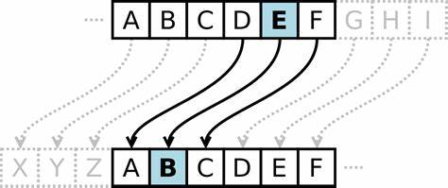
Caesar Cipher Algorithm
Description: A substitution cipher involving shifting each letter in the plaintext by a specific number of positions in the alphabet.
Example: With a key value of 3, each character is shifted three positions.

Slide 6
LITERATURE REVIEW

Slide 7



Threshold Visual Cryptography and Abbreviations
Threshold Cryptography
Abbreviations
Units
Define terms the first time, avoid unnecessary acronyms
Use consistent SI or CGS units, avoid mixing systems
Divides secret into multiple shares, requires minimum to reveal

Slide 8
Units and Equations
Equation Formatting
Equation Numbering
Use Times New Roman or Symbol font
Number equations consecutively, position flush right
Equation Formatting
Variable Formatting
Use solidus, exp function, or exponents to keep compact
Italicize Roman symbols, not Greek symbols

Slide 9



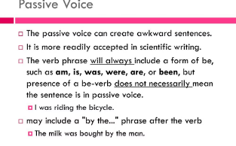
Common Mistakes in Scientific Writing
Unclear Writing
Grammar and Spelling Errors
Improper Citations
Excessive Passive Voice
Avoid jargon and use simple, straightforward language.
Proofread carefully to catch mistakes that undermine credibility.
Follow formatting guidelines precisely to avoid plagiarism.
Use active voice to engage the reader and clarify responsibility.

Slide 10
Using the Template
1
Duplicate the Template
Use the Save As command to create a new file
2
Import Text
Paste your prepared text into the new file
3
Style the Paper
Use the MS Word Formatting toolbar to apply styles

Slide 11

Figures and Tables
When presenting research findings, the proper use of figures and tables is crucial for effectively communicating information to the reader [1]. The positioning of these visual elements should be carefully considered, with the recommendation to place them at the top or bottom of columns rather than in the middle [2].
Clear and descriptive captions and labels are essential for helping the reader understand the content of the figures and tables [3]. Consistency in the citation and introduction of these elements throughout the text is also important for maintaining flow and clarity [4].

Slide 12
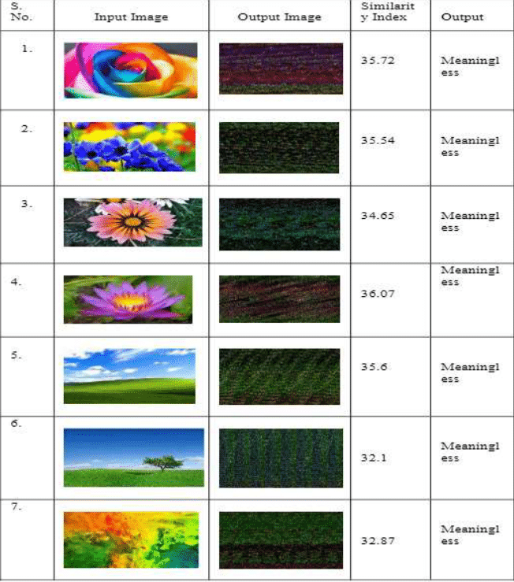
Result Analysis
Similarity Indices:
The table provides similarity indices between input images and their corresponding processed output images.
Higher similarity indices indicate that the processed output image is more similar to the original input image.
Meaningfulness:
The last column in the table is labeled “Meaningfulness.”
Unfortunately, the specific meaning or context behind this term is not provided.
Without further details, we cannot definitively conclude what “meaningfulness” refers to in this context.

Slide 13
Result Analysis
Possible Interpretations:
Given the lack of context, we can only speculate on potential interpretations:
Image Enhancement: The processed output images might represent enhanced versions of the input images (e.g., noise reduction, color correction, etc.).
Lossy Compression: The similarity indices could be related to evaluating the quality of lossy compression algorithms (where higher similarity indicates better preservation of image content).
Feature Extraction: The similarity indices might be used for feature extraction or pattern recognition tasks.
Machine Learning: Perhaps these indices are part of a machine learning model evaluation (e.g., comparing original and reconstructed images).
Additional Context Needed:
To draw more meaningful conclusions, we would need additional context or information about the purpose of this analysis.
Knowing the domain (e.g., image processing, computer vision, or a specific application) would help us interpret the results better.

Slide 14
Conclusion
In secure communication, safeguarding data is crucial, driving the exploration of various visual cryptography schemes. A notable innovation is Visual Cryptography (VC), designed for securely sharing confidential images. VC encodes an image into multiple shares, which can be physical transparencies or digital files.

Slide 15
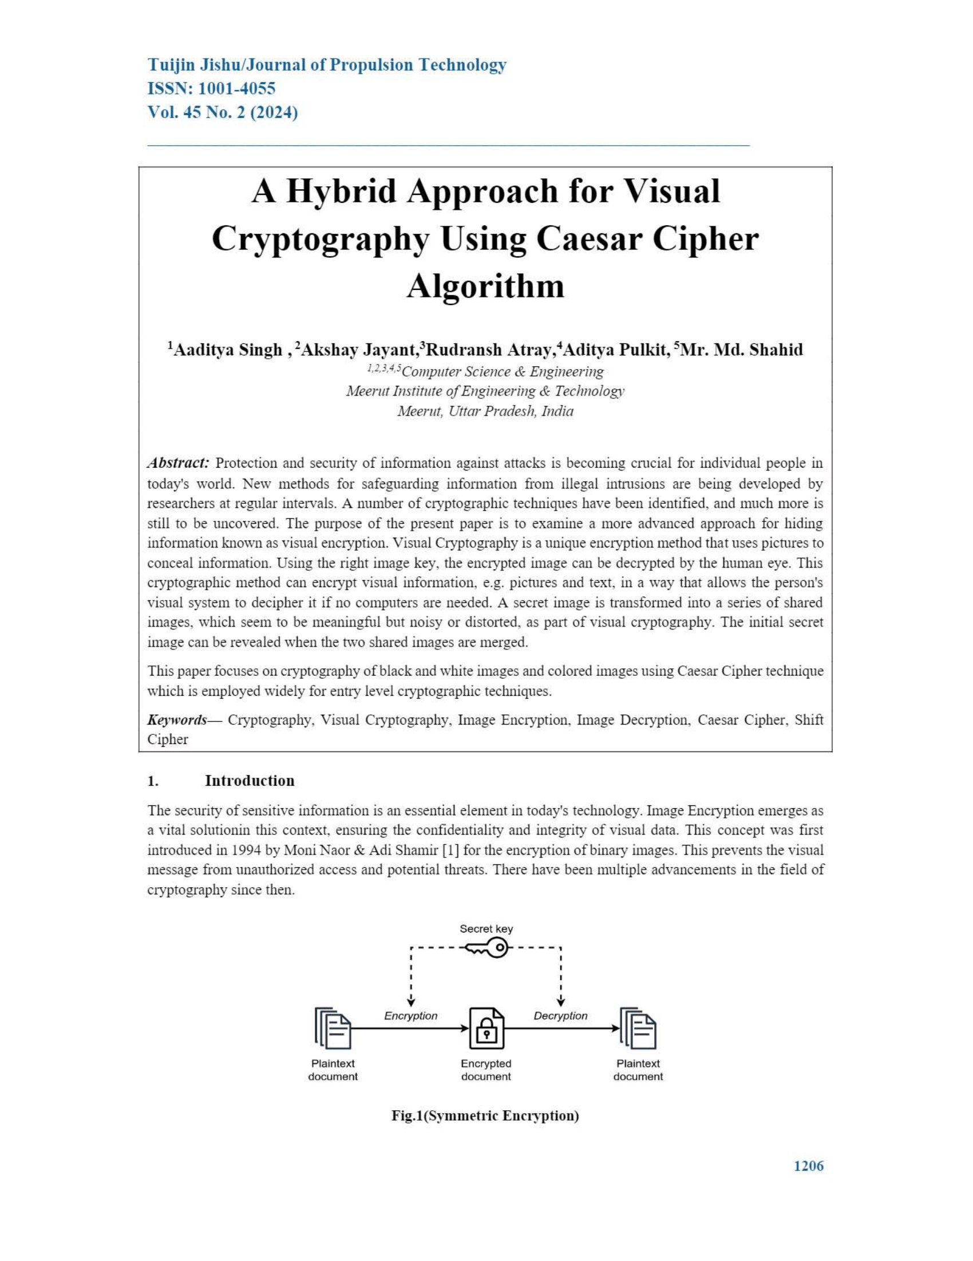
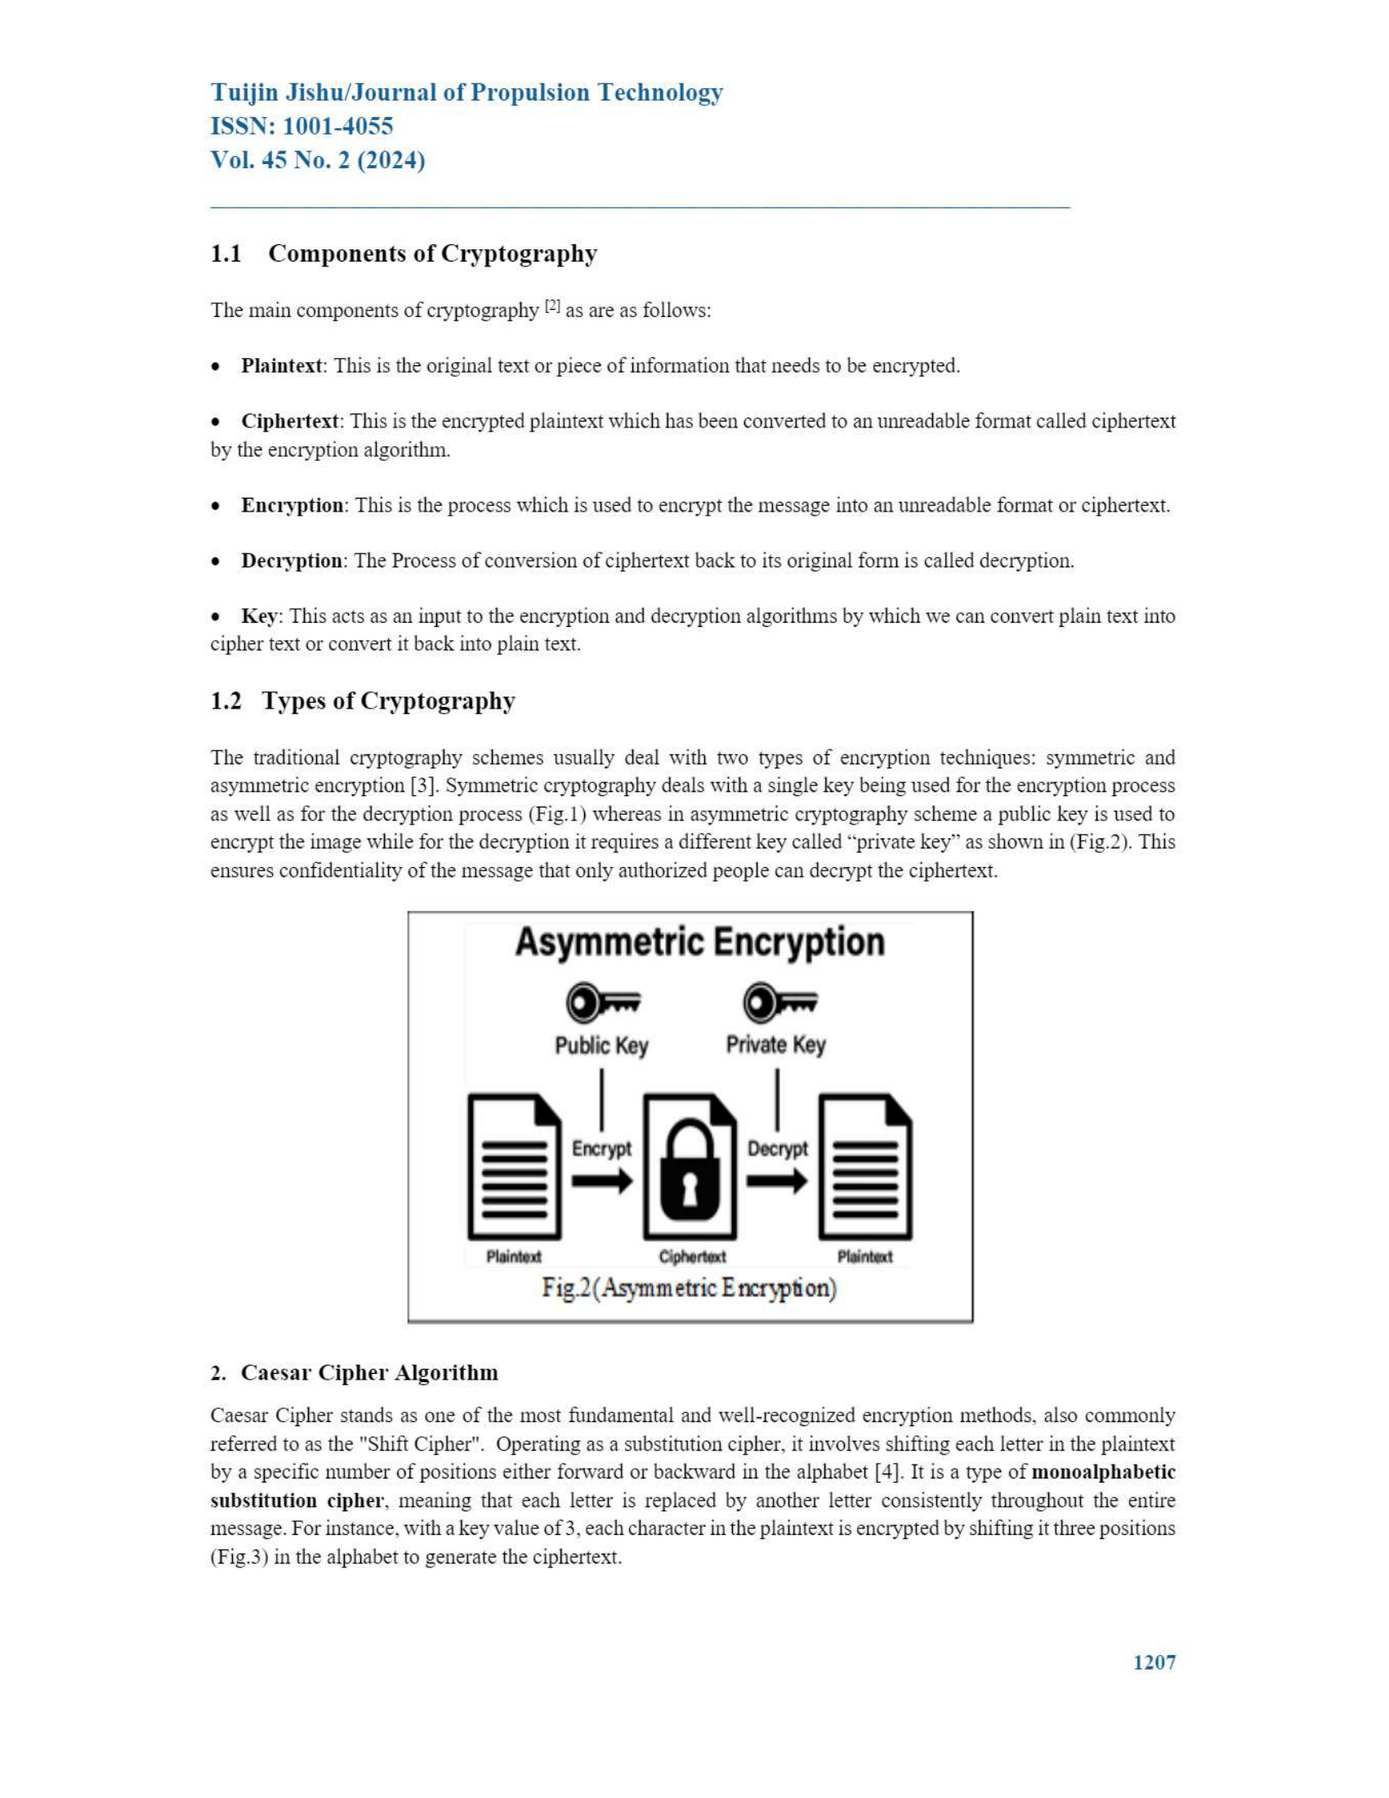
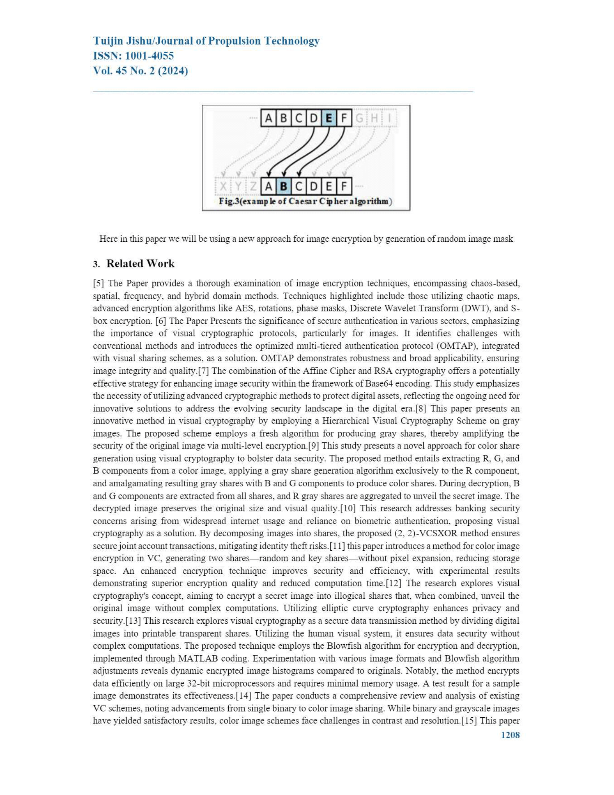
Base Paper

Slide 16
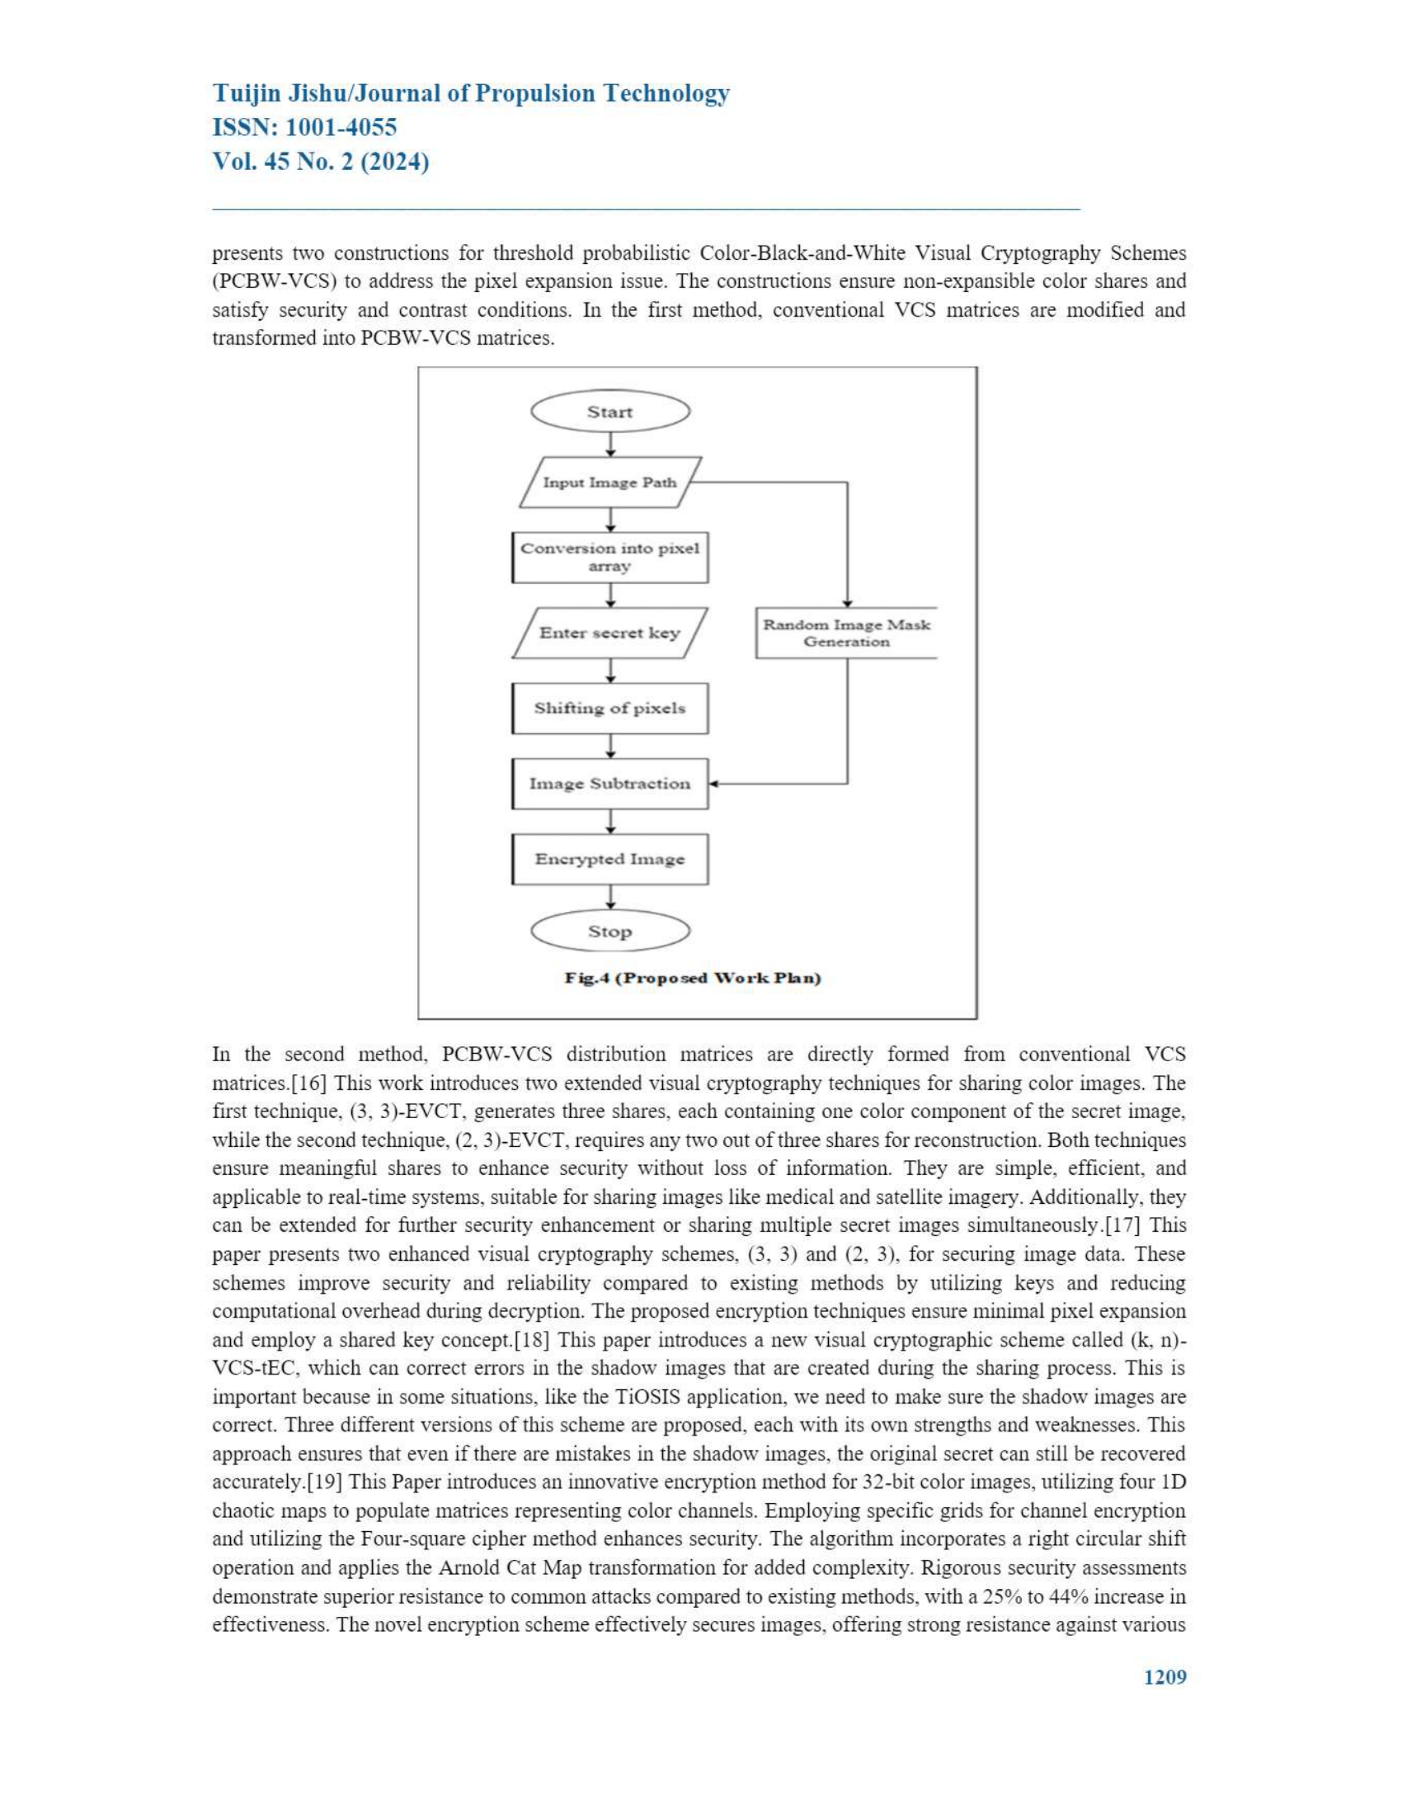
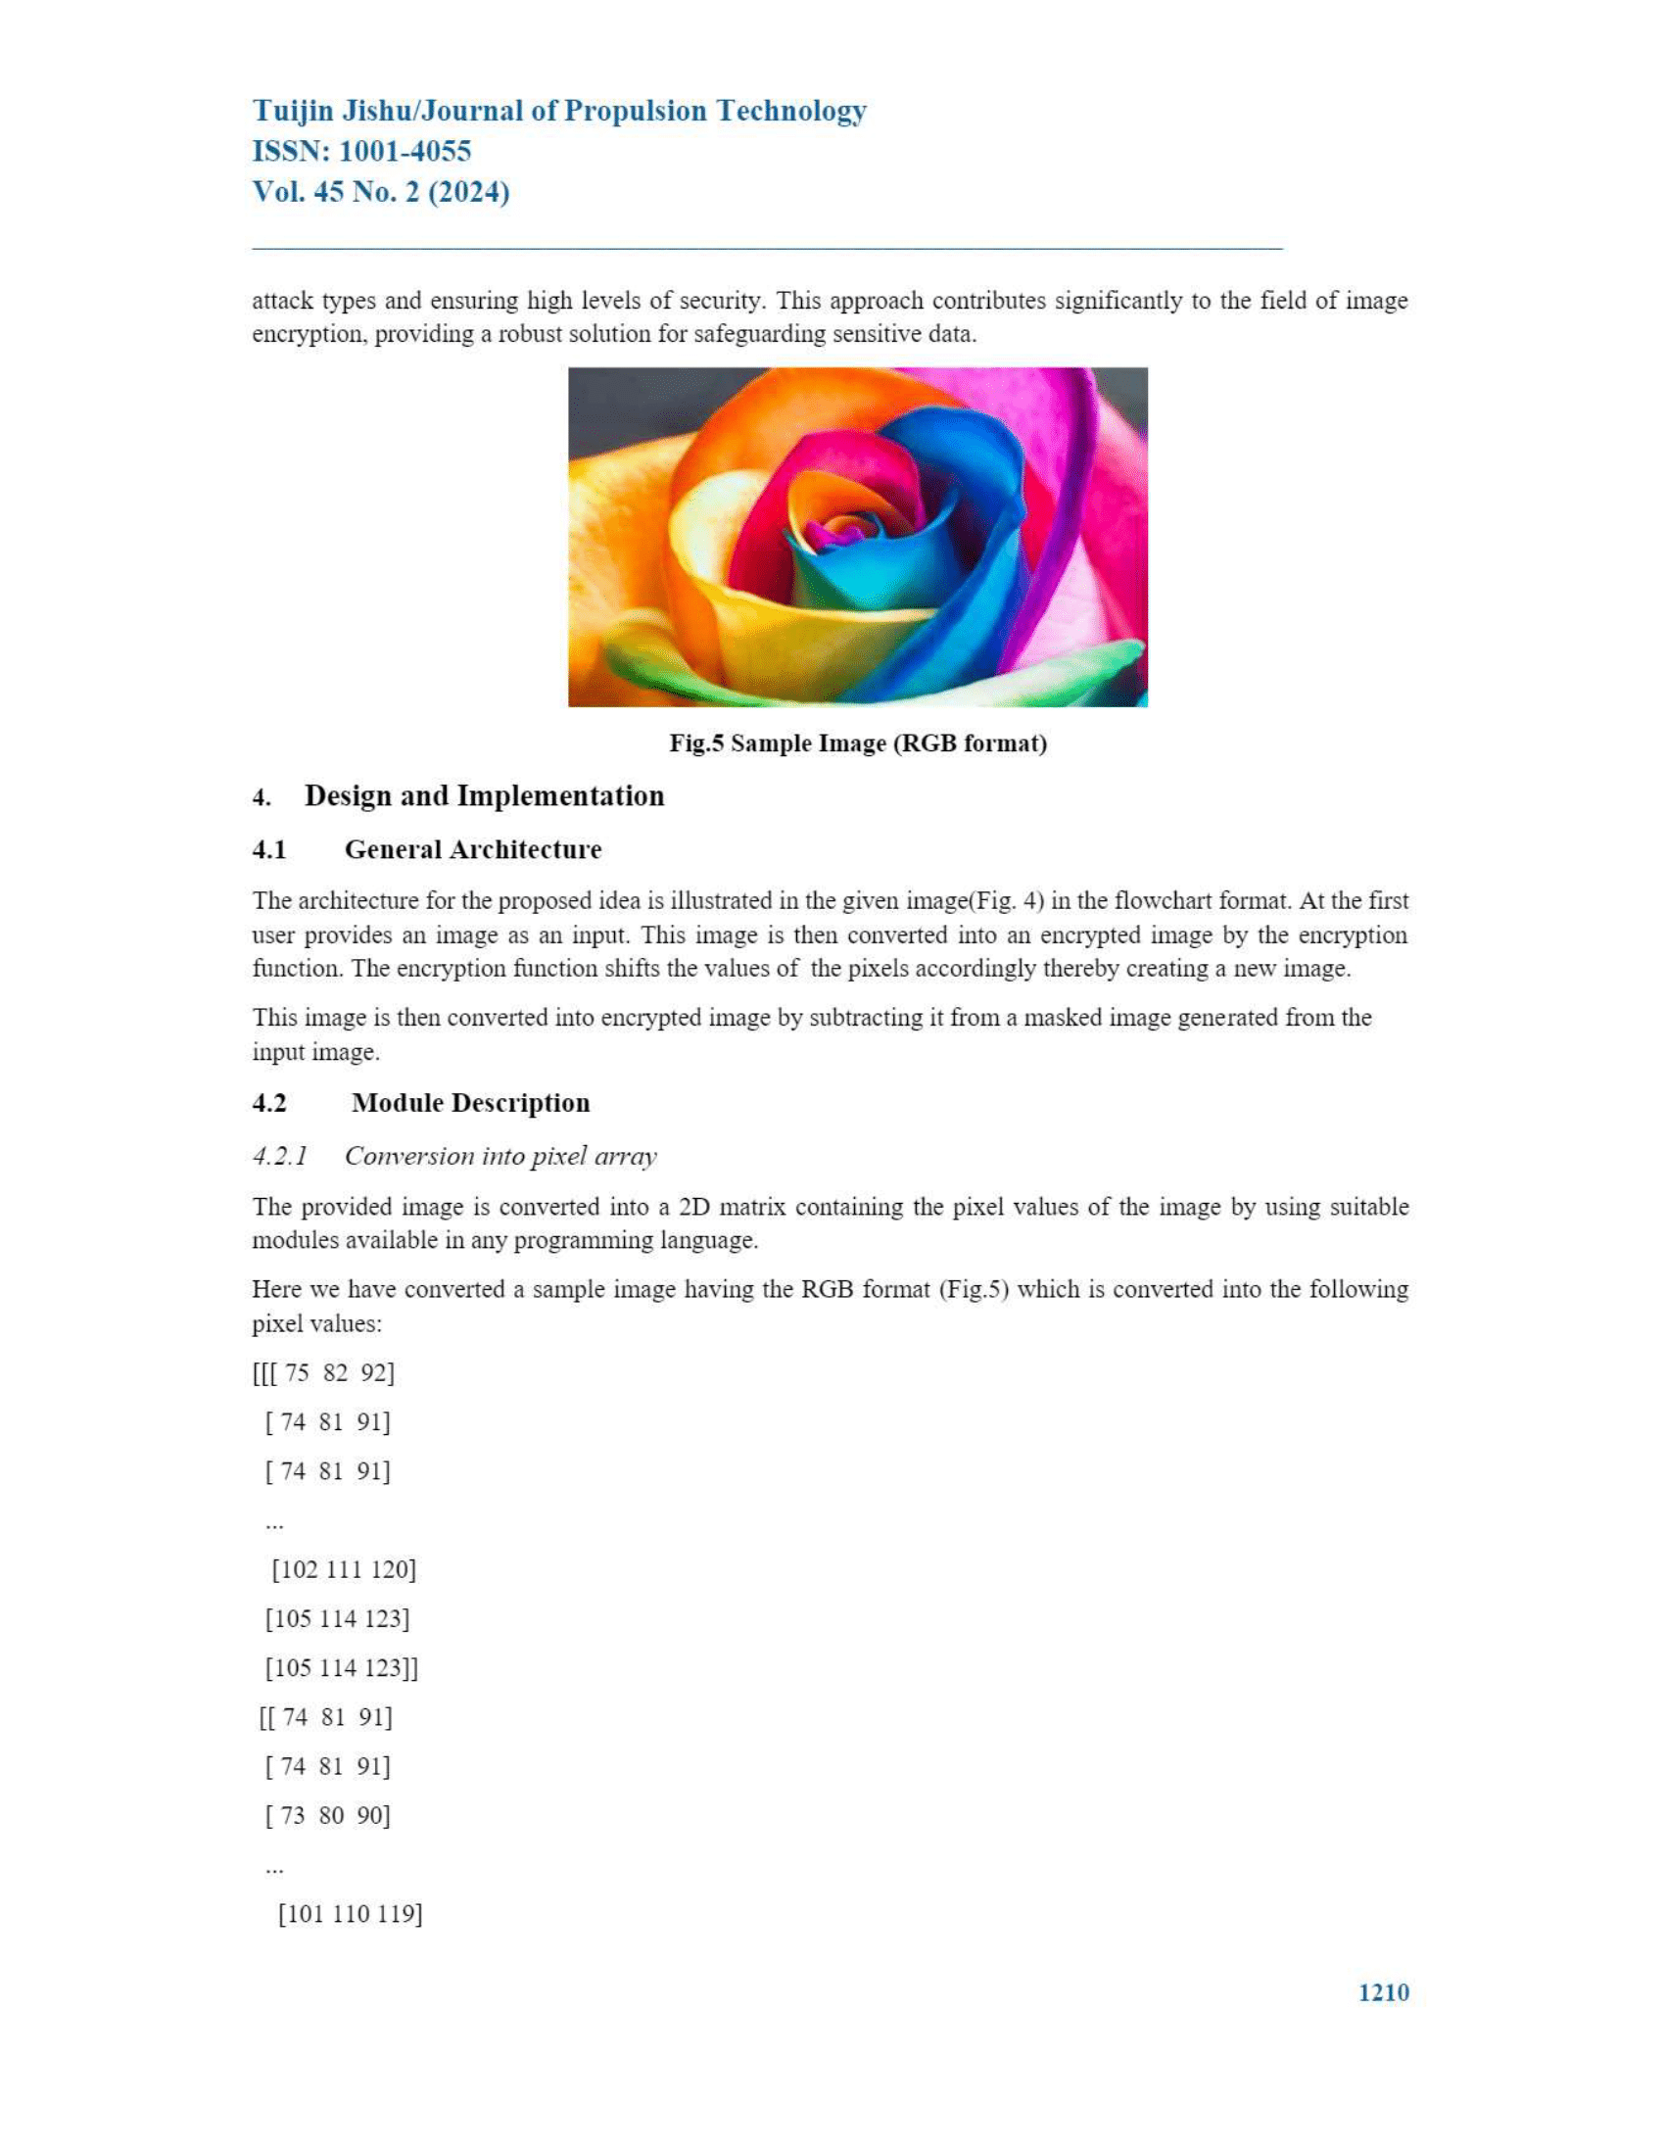
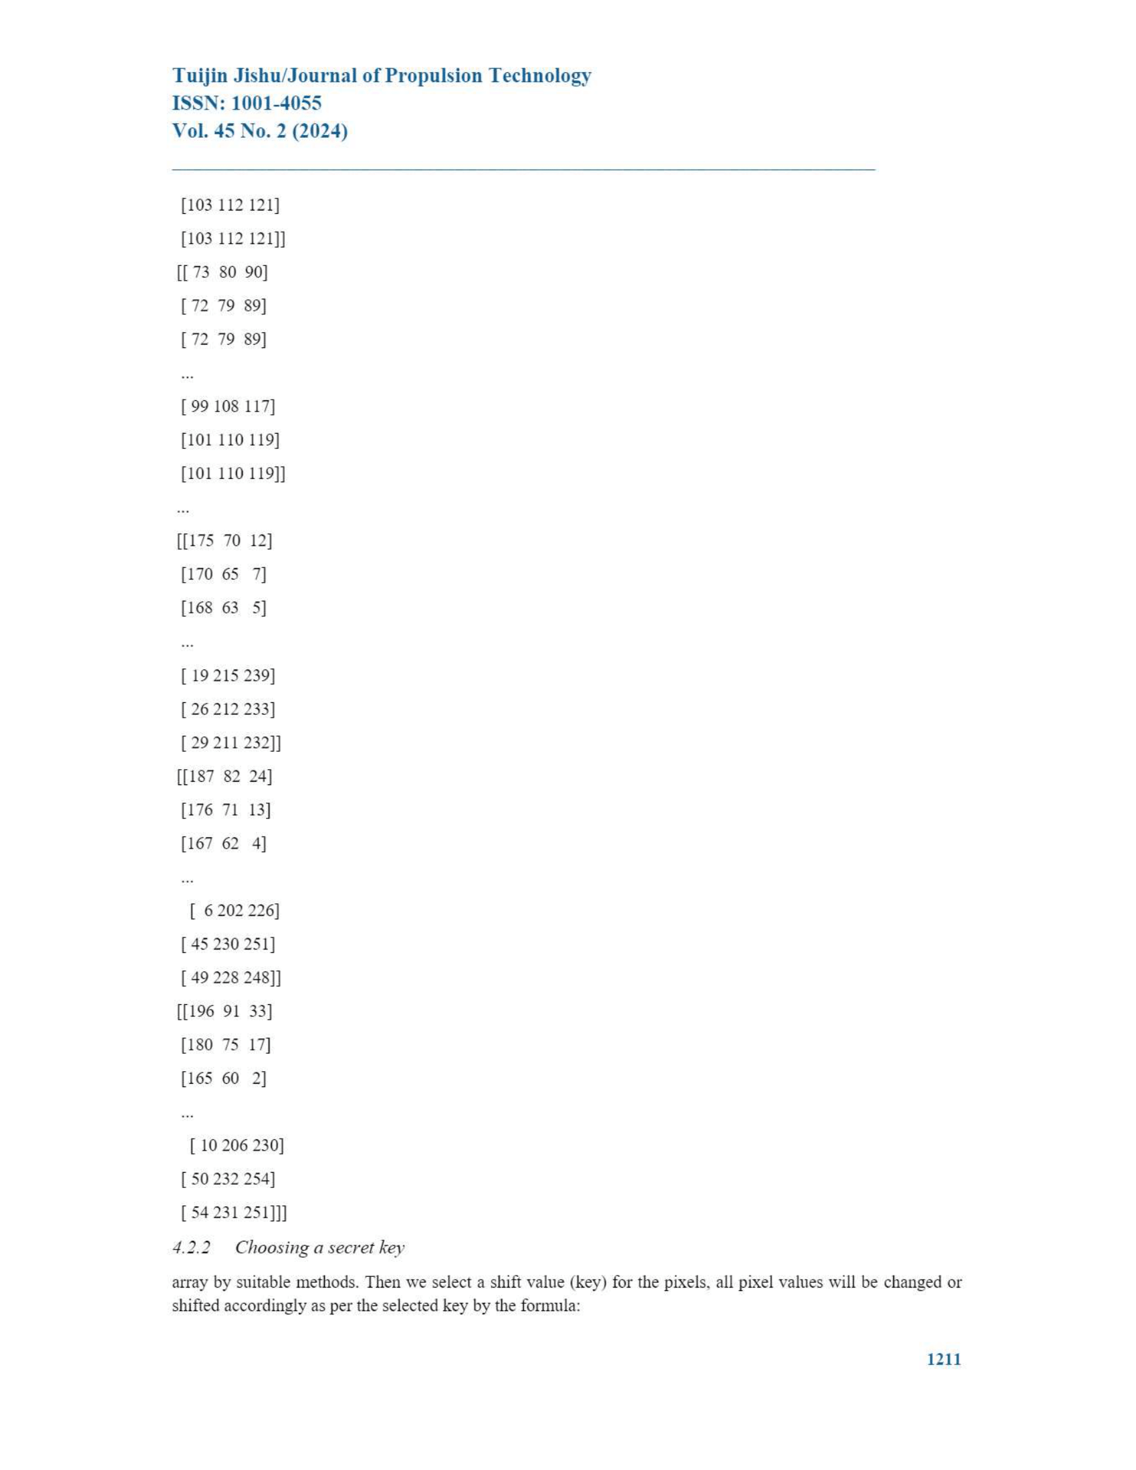
Base Paper

Slide 17
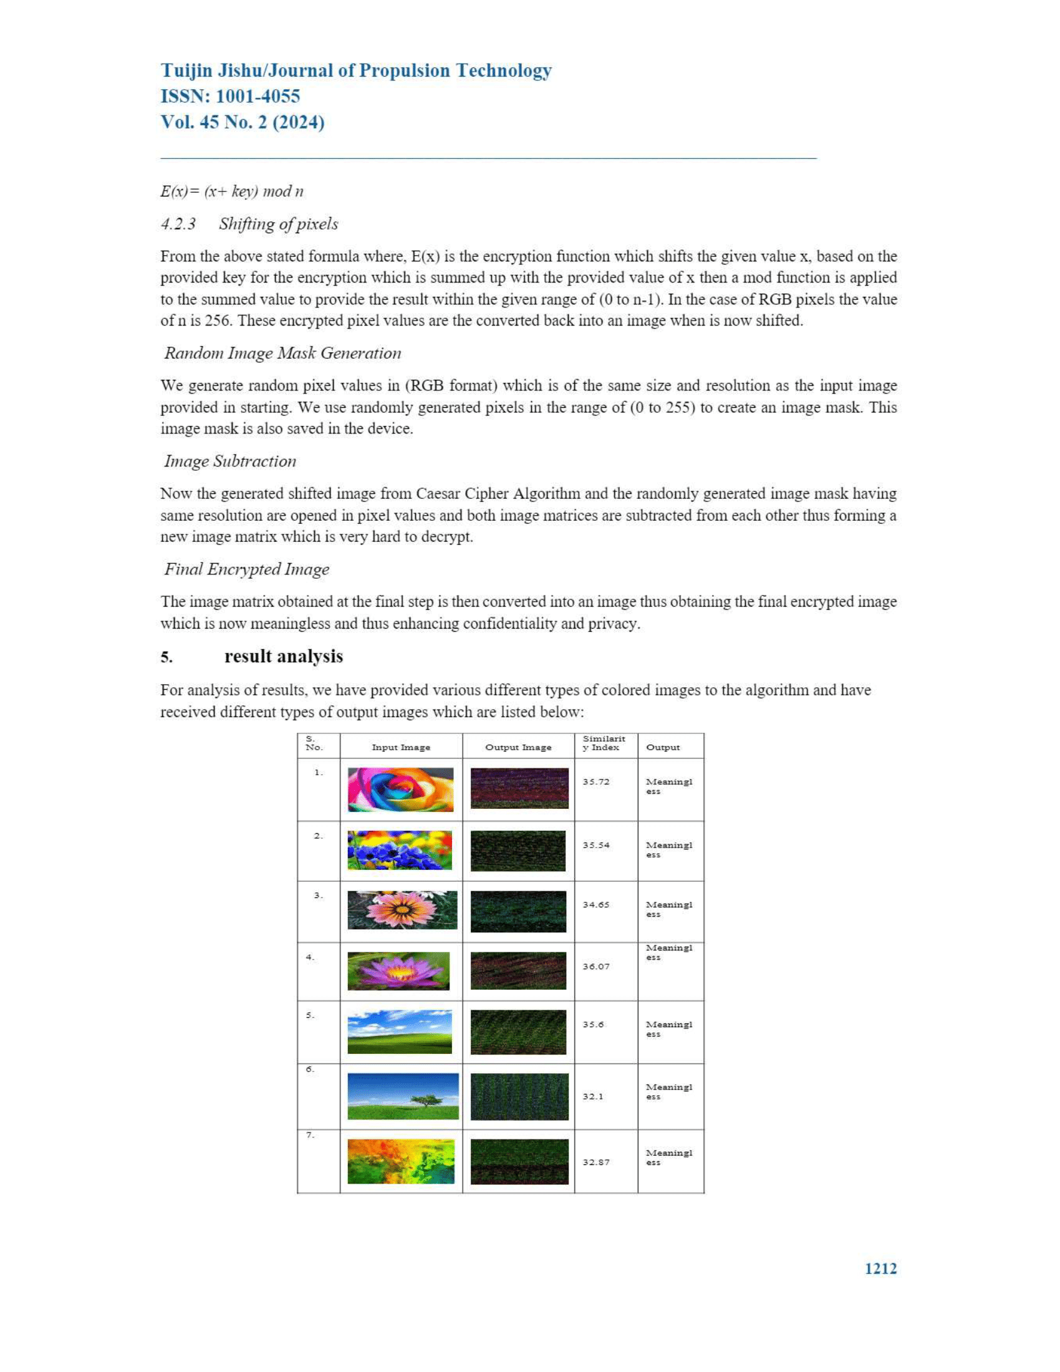
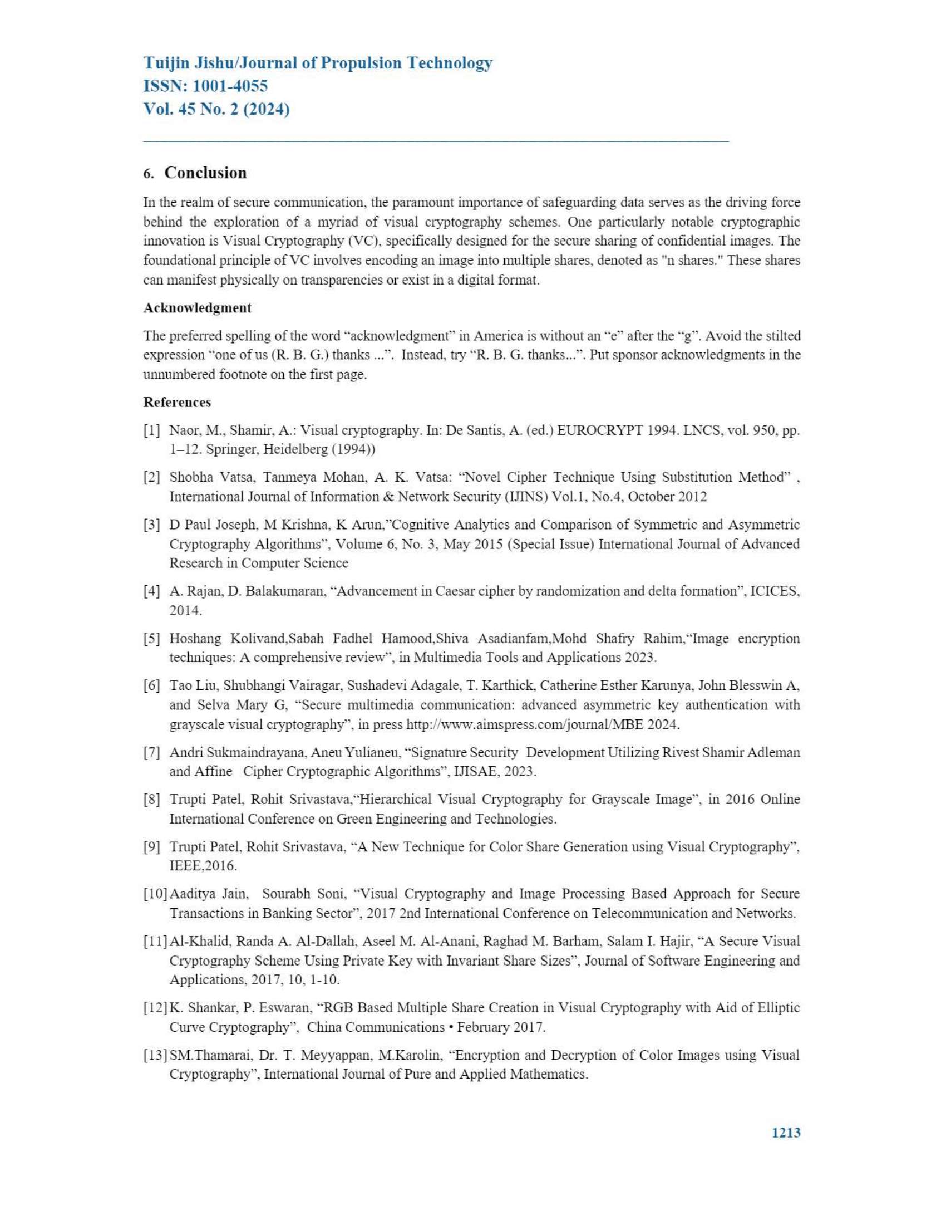
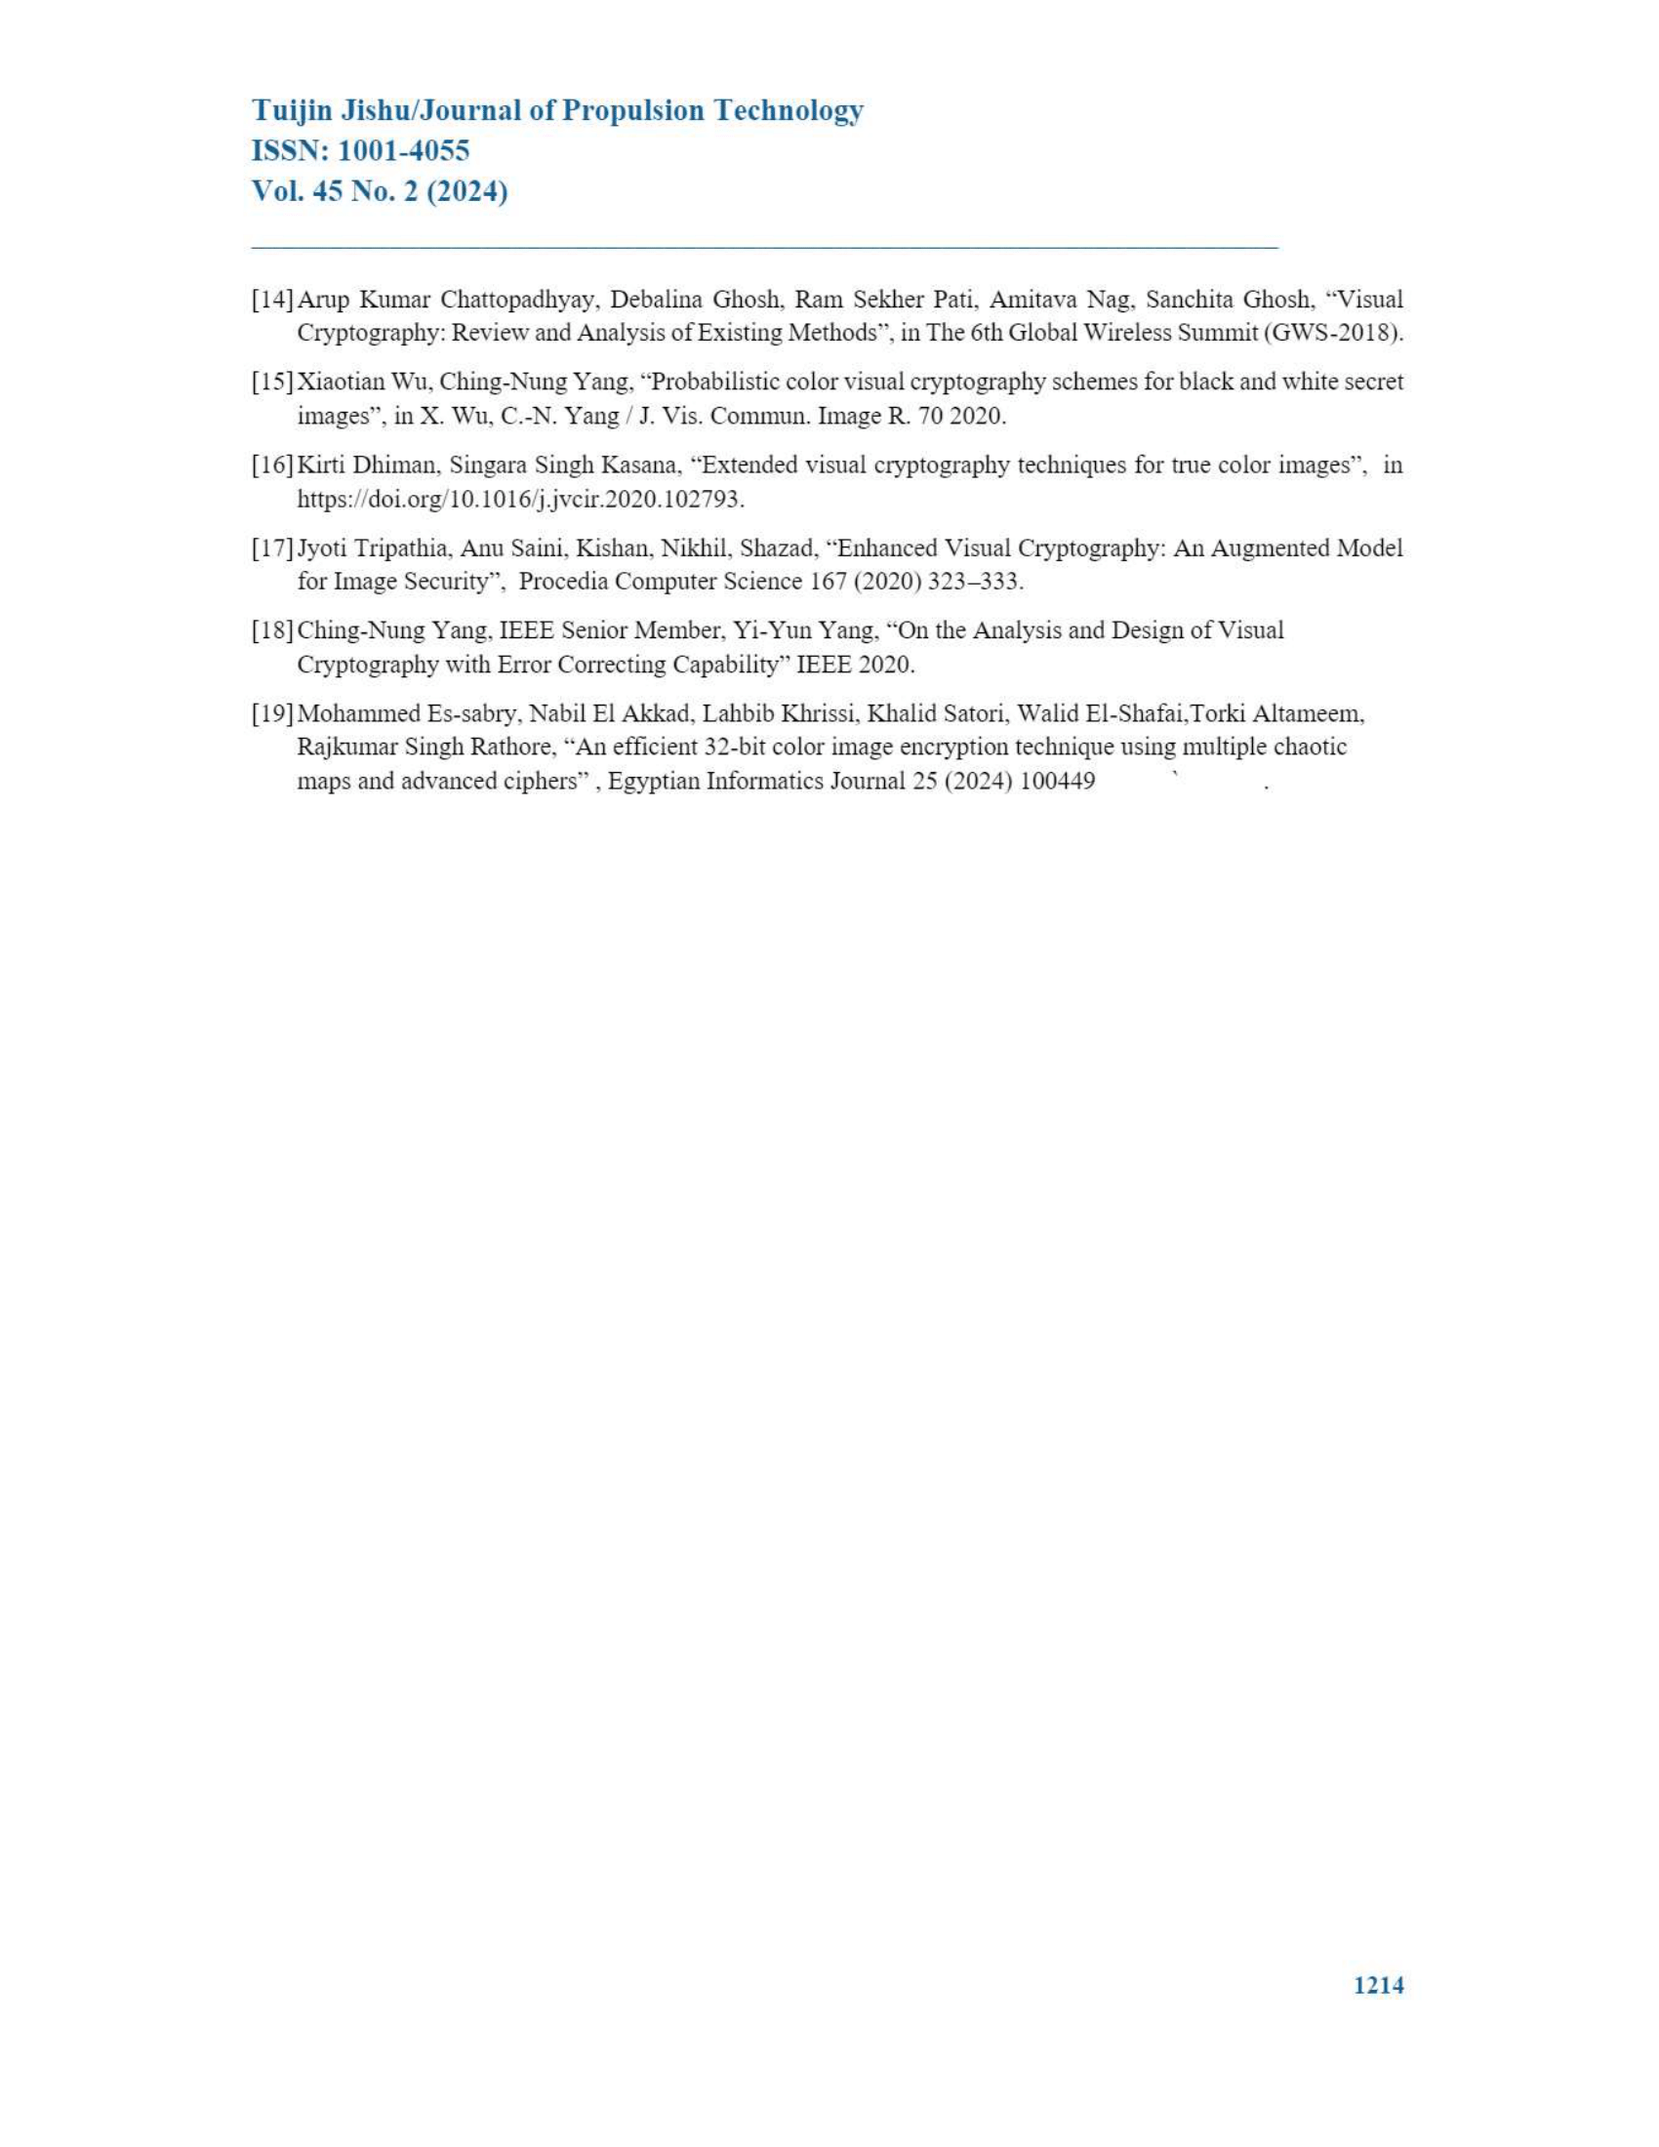
Base Paper

Slide 18

Research Paper Link
https://propulsiontechjournal.com/index.php/journal/article/view/6021/3982

Slide 19
References
Naor, M., Shamir, A.: Visual cryptography. In: De Santis, A. (ed.) EUROCRYPT 1994. LNCS, vol. 950, pp. 1–12. Springer, Heidelberg (1994))
Shobha Vatsa, Tanmeya Mohan, A. K. Vatsa: “Novel Cipher Technique Using Substitution Method” , International Journal of Information & Network Security (IJINS) Vol.1, No.4, October 2012
D Paul Joseph, M Krishna, K Arun,”Cognitive Analytics and Comparison of Symmetric and Asymmetric Cryptography Algorithms”, Volume 6, No. 3, May 2015 (Special Issue) International Journal of Advanced Research in Computer Science
A. Rajan, D. Balakumaran, “Advancement in Caesar cipher by randomization and delta formation”, ICICES, 2014.
Hoshang Kolivand,Sabah Fadhel Hamood,Shiva Asadianfam,Mohd Shafry Rahim,“Image encryption techniques: A comprehensive review”, in Multimedia Tools and Applications 2023.
Tao Liu, Shubhangi Vairagar, Sushadevi Adagale, T. Karthick, Catherine Esther Karunya, John Blesswin A, and Selva Mary G, “Secure multimedia communication: advanced asymmetric key authentication with grayscale visual cryptography”, in press http://www.aimspress.com/journal/MBE 2024.

